Slide 1
React v
s Angular
React is JavaScript library
Angular is JavaScript framework
React maintained and supported by Facebook and community
Angular maintain and supported by Google and community
React is a JavaScript library for building user interfaces.
Angular is an application design framework and development platform for creating efficient and sophisticated single-page apps.
use TypeScript as primary language
In React you can use JSX for for convenience and better code readability
we can also write our components in TypeScript instead of JavaScript
can be added to any page as a external script
Angular Ivy(Incremental DOM)
Need less memory than VirtualDOM
VirtualDOM
Faster than Angular Ivy
You can use Create-React-App to install and get a customized project

Slide 2
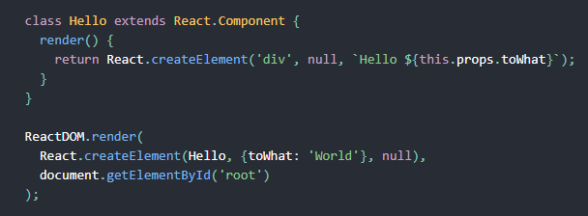
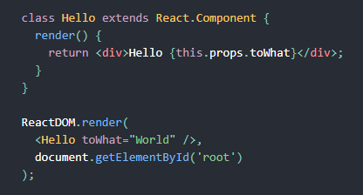
React with JSX and without

Slide 3
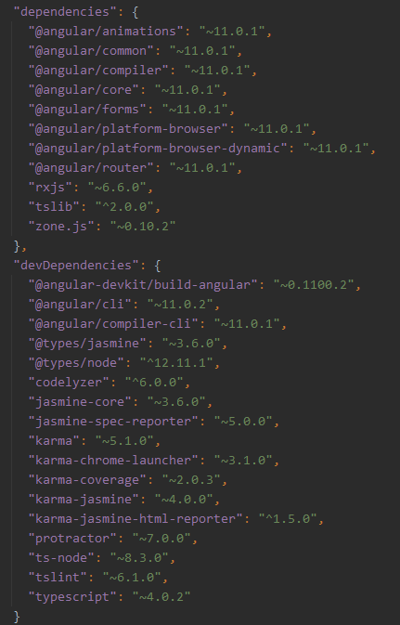
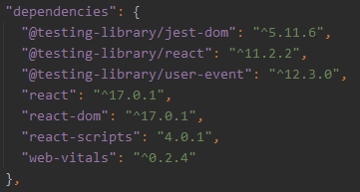
Create-React-App v
s Angular

Slide 4
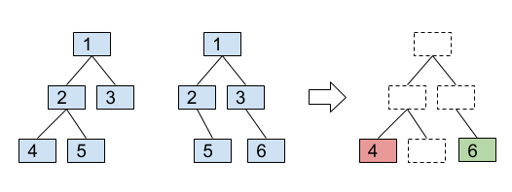
React VirtualDOM

Slide 5
Props v
s State
Props are variables passed to it by its parent component
State is still variables, but directly initialized and managed by the component
Props are read-only for component
Must be modified by setState() function or useState hook
Component’s props can changed by component’s parent
Component without state called stateless.
They has not lifecycle methods
Props can used to allow child components to access methods defined in the parent component

Slide 6
Component initialization
Waits until props/state update
Removing a component
constructor()
setState()
props has changed by parent
static getDerivedStateFromProps()
For write something from props to state
Get props
Return object
this.state is no updated here
static getDerivedStateFromProps()
For write something from props to state
Get props
Return object
render()
Has child component?
shouldComponentUpdate()
this.state updated to nextState
render()
componentWillUnmount()
Child’s
constructor()
static getDerivedStateFromProps()
render()
Has child component?
Child’s
constructor()
static getDerivedStateFromProps()
render()
Child’s
componentDidiMount()
Child’s
getSnapshotBeforeUpdate()
Component will never be mounted again
getSnapshotBeforeUpdate()
Excellent place to get side effects
getSnapshotBeforeUpdate()
componentDidiMount()
Child’s
componentDidUpdate()
draw/update
component on front
componentDidUpdate()

Slide 7
Side effects
Modifying a global variable
Screen recording
Write to file
Any network request like AJAX request.

Slide 8
React component
state and lifecycle
Lifecycle Hook | What is it for? | What cannot be done here?
shouldComponentUpdate | to optimize component performance
componentDidUpdate | Do side effects (AJAX calls, etc.) | setState() here give you infinity update
componentDidMount | Do side effects (AJAX calls, etc.) | setState() here give you infinity update
componentWillUnmount | Remove timers and listeners created during the lifetime of the component. | Do not call setState(), do not set new listeners or run timers
static getDerivedStateFromProps | To set component’s state from props
getSnapshotBeforeUpdate | to capture some information from the DOM (e.g. scroll position) problem example
static getDerivedStateFromError | Recive error thrown by a descendant component. Should return a value to update state.
componentDidCatch | Recive error thrown by a descendant component(used for things like logging errors)

